Slide 1
What’s in a company profile? Take 10 minutes & find out… (hint: it’s great for ABM)
GovCon Ideation
12/3/24

Slide 2
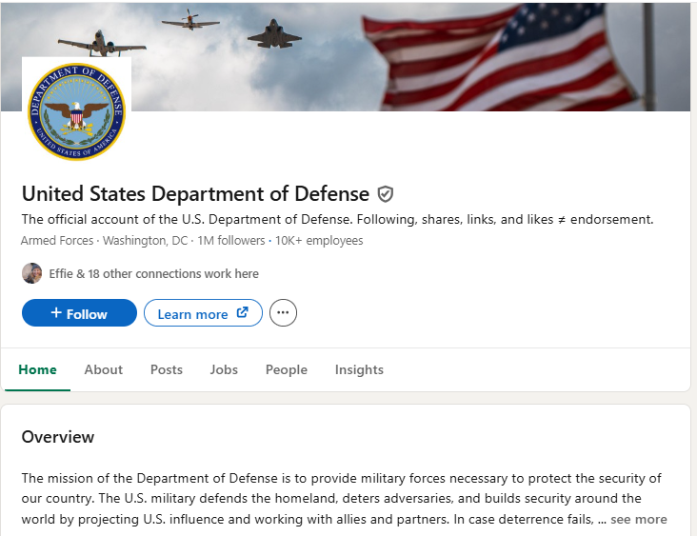
Pick an agency page

Slide 3
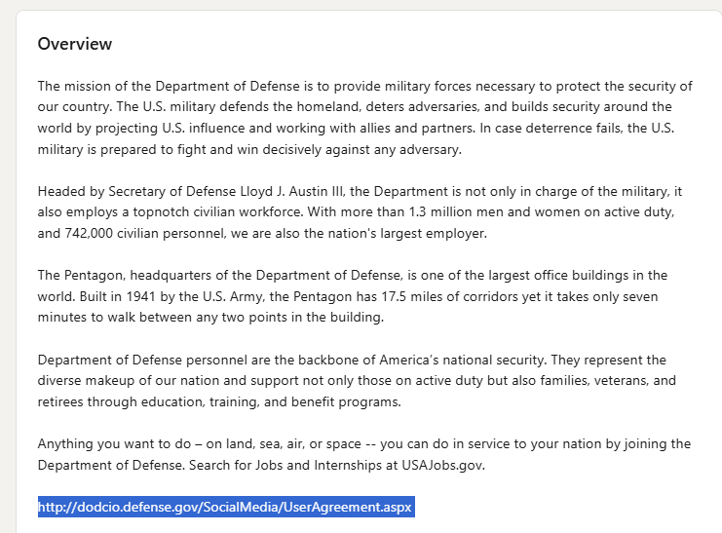
Read the overview

Slide 4
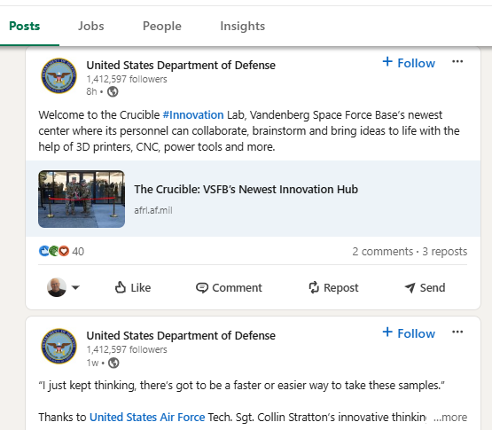
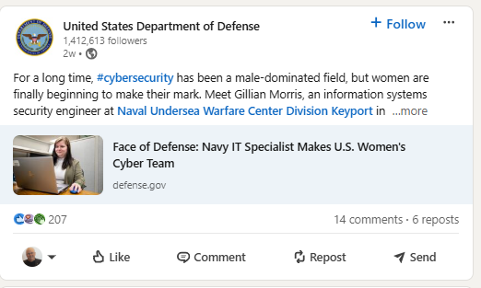
Find content worth sharing and tag people mentioned

Slide 5
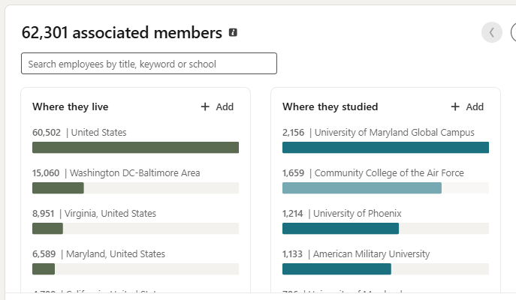
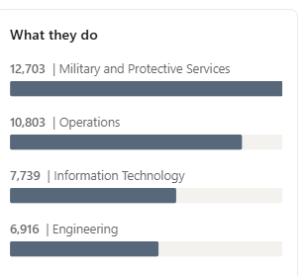
Need stats?

Slide 6
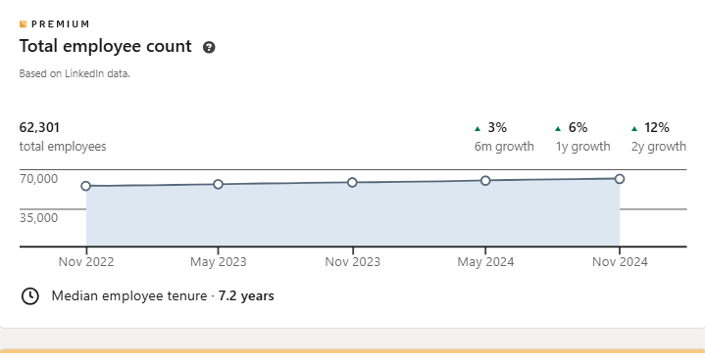
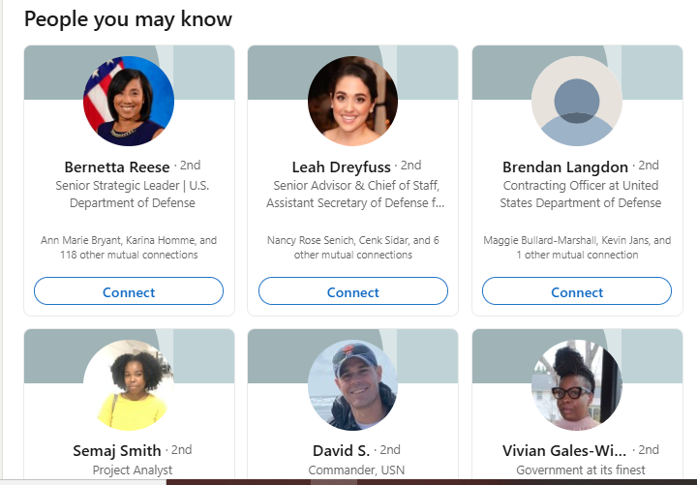
More Stats

Slide 7
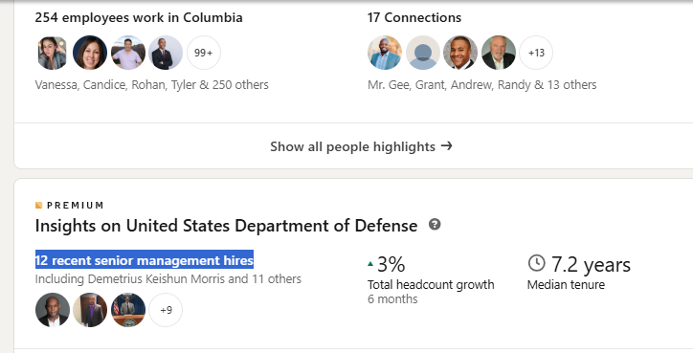
How many people are you connected with

Slide 8
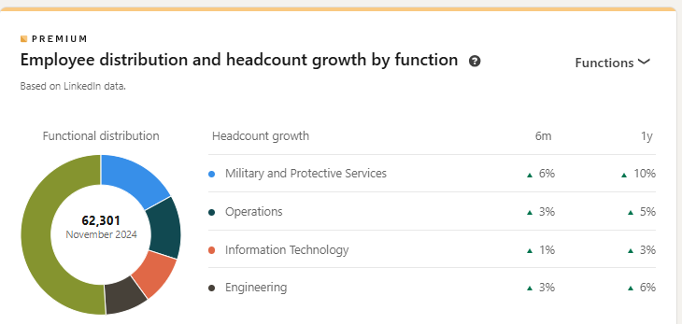
General info

Slide 9
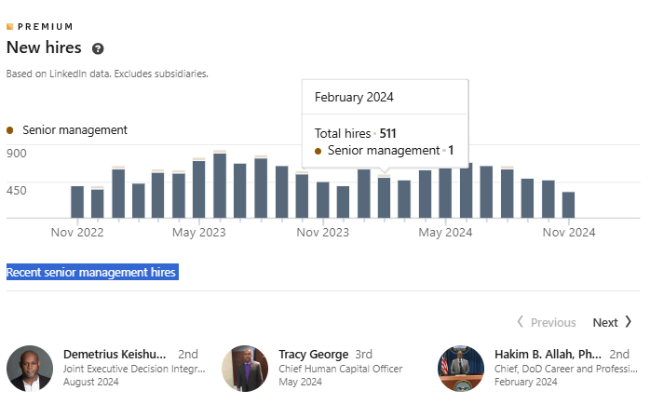
Recent hires are listed

Slide 10
Taking a few minutes to parse company pages can
Give you fodder for posts
Identify new key players
Give you stats for meetings
Increase your knowledge base of a particular client organization

