Slide 1
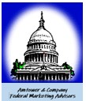
Using Social for ABM: A Case Study
GovCon Ideators
January 21, 2025

Slide 2
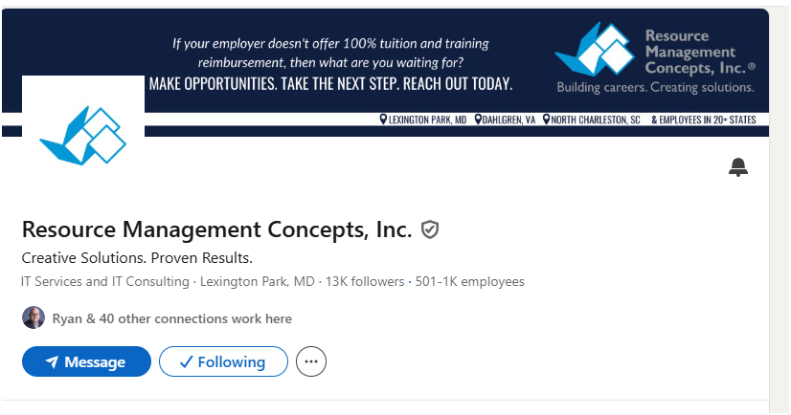
RMC Background
Funded 1992
2 employees
Focused on RDT&E
and scientific computing
Small business
Moderate growth in the 1990s
Focused on Pax River and NAWCAD, expanding their footprint at Pax River, a mix of sub-contracts and small primes

Slide 3
RMC growth, 1990s – early 2000s
Focused on Naval Warfare Centers requiring RDT&E (now RDAT&E)
They expanded to related Naval warfare centers
Carderock
Dahlgren
Indianhead
Crane
And beyond

Slide 4
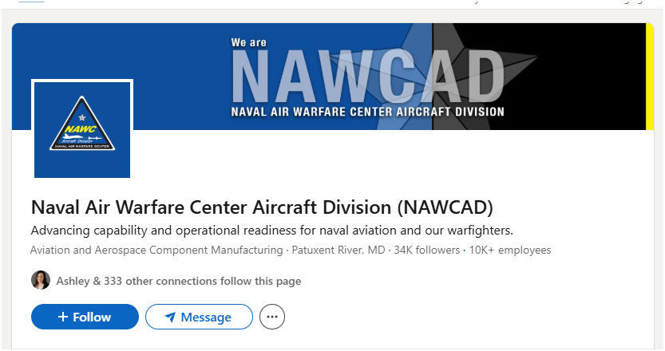

Slide 5
RMCs use of LinkedIn for growth
First, identifying key personnel (contracting, program managers, key IT staff)
Second, content sharing, including
Contract wins
Employee engagement in the communities where they work
Employee recognition
Employee gatherings
Client recognition
Upcoming events

Slide 6
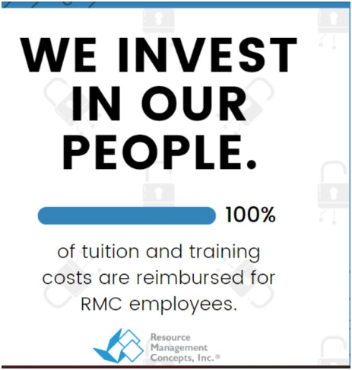
Employee/recruitment perks

Slide 7
RMC has multiple background banners highlighting different aspects of the company

Slide 8
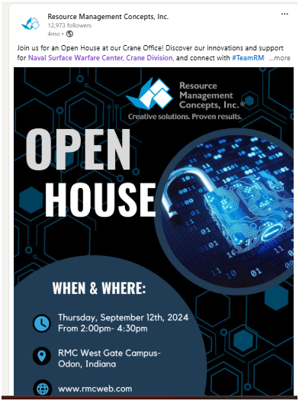
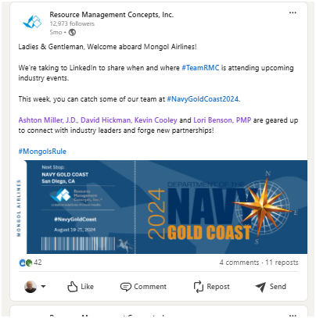
Education & Events

Slide 9
RMC defines the account as any Naval Warfare Center
As of summer 2024, they have contracts at all 6 Naval Warfare Centers, NIWC Atl & NIWC Pac
Before going after any NWC, they do recon via LinkedIn for key personnel, competitors, who’s who in the associations serving that community
A big part of RMC is the employee loyalty & retention, ergo “the IT Horde”
RMC is approaching 1,000 employees and remains focused on Navy RDAT&E and supporting the warfare centers

